Slide 1

Schedules and types of schedules
Database Management System | Transaction Management and Scheduling
Course: Database Management System | Chapter: Transaction Management and Scheduling | Program: B.TECH-CSE, B.TECH CSE - CYBER SECURITY, B.TECH CSE - DATA
DISCOVER · LEARN · EMPOWER
Notes:
Welcome everyone to today's session on Transaction Management. We are diving deep into how database systems handle concurrent operations through schedules. This is a critical topic for ensuring data integrity in real-world applications. Let us begin by understanding the fundamental building blocks of concurrency control.

Slide 2
Course Outcomes
SLIDE 2 / 14
Course Outcome
CO | BT LEVEL | DESCRIPTION
CO1 | BT2 | Explain database architecture, relational model concepts and formal query language foundations including relational algebra and relational calculus.
CO2 | BT3 | Apply relational algebra, relational calculus and SQL constructs to formulate correct and efficient database queries.
CO3 | BT4 | Analyze functional dependencies and design normalized relational schemas up to 5NF ensuring lossless join and dependency preservation.
CO4 | BT4 | Analyze transaction schedules and concurrency control mechanisms to determine serializability, recoverability and correctness.
CO5 | BT5 | Evaluate storage structures, indexing strategies and query optimization techniques for performance, scalability and reliability.
Chandigarh University
2 / 14
Notes:
Today's lecture directly addresses CO4 by teaching you how to analyze schedules for correctness. We will also touch upon CO5 as efficient scheduling impacts overall system performance and scalability. Understanding these outcomes ensures you can build robust database applications. Please note these specific objectives as we progress through the slides.

Slide 3
Learning Objectives
SLIDE 3 / 14
Learning Outcomes
1
Define a schedule and explain its role in concurrent transaction execution.
2
Analyze the differences between serial and concurrent schedule execution models.
3
Evaluate serializability criteria to determine if a schedule is correct.
4
Classify schedules into conflict serializable, view serializable, and recoverable types.
5
Apply equivalence rules to transform complex schedules into serial forms.
Chandigarh University
3 / 14
Notes:
By the end of this session, you will be able to define what a schedule is in the context of transactions. You will learn to distinguish between serial and concurrent execution models clearly. We will evaluate how to check if a schedule is serializable using specific criteria. Finally, you will classify schedules into various types like conflict or view serializable.

Slide 4
Lecture
SLIDE 4 / 14
Definition of a Schedule
1
A schedule is a sequence of instructions from multiple transactions executed over time.
2
It preserves the relative order of instructions within each individual transaction.
3
Instructions include read operations, write operations, commit, and abort actions.
4
The scheduler determines the interleaving of operations from different transactions.
5
A valid schedule must ensure that no transaction reads uncommitted data.
Chandigarh University
4 / 14
Notes:
Think of a schedule as a playlist where songs from different albums are mixed together. The order of songs within each album must remain unchanged, but albums can be interleaved. For example, if T1 reads X then writes X, T2 cannot insert a read of X between them. This interleaving is what creates concurrency challenges.

Slide 5
Lecture
SLIDE 5 / 14
Serial vs Concurrent Schedules
1
A serial schedule executes one transaction completely before starting the next.
2
A concurrent schedule interleaves operations from two or more transactions.
3
Serial schedules are always correct but offer poor system throughput.
4
Concurrent schedules improve resource utilization but risk data inconsistency.
5
The goal is to find a concurrent schedule equivalent to a serial one.
Chandigarh University
5 / 14
Notes:
In a serial schedule, T1 finishes entirely before T2 begins, ensuring no conflicts. However, this wastes CPU time while one transaction waits. A concurrent schedule allows T1 and T2 to run simultaneously, boosting throughput. The challenge is ensuring this interleaving does not produce incorrect results.

Slide 6
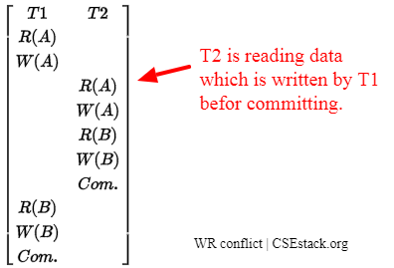
Lecture
SLIDE 6 / 14
Conflict Equivalence Concept
1
Two schedules are conflict equivalent if they have the same operations.
2
They must preserve the order of conflicting operations between transactions.
3
Conflicts occur when operations access the same data item with at least one write.
4
Read-Read operations do not cause conflicts and can be reordered freely.
5
Read-Write and Write-Write operations create dependencies that must be preserved.
Source: www.csestack.org
Chandigarh University
6 / 14
Notes:
Conflict equivalence is the foundation for checking serializability. If two schedules have the same operations but different orders of conflicting actions, they are not equivalent. For instance, if T1 writes X and T2 reads X, swapping them changes the result. We must preserve this order to maintain correctness.

Slide 7
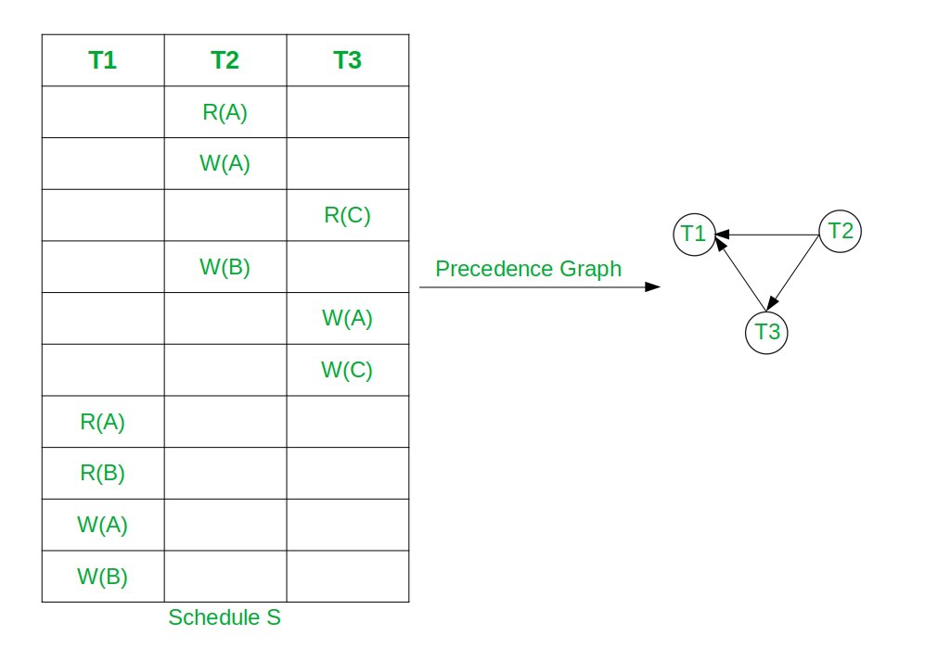
Lecture
SLIDE 7 / 14
Conflict Serializability Criteria
1
A schedule is conflict serializable if it is conflict equivalent to a serial schedule.
2
We use a precedence graph to test for conflict serializability efficiently.
3
Nodes in the graph represent transactions involved in the schedule.
4
A directed edge exists from Ti to Tj if Ti conflicts with Tj.
5
The schedule is serializable if and only if the graph has no cycles.
Source: media.geeksforgeeks.org
Chandigarh University
7 / 14
Notes:
To test if a schedule is conflict serializable, we build a precedence graph. Each node represents a transaction, and edges show dependencies. If T1 writes X and T2 reads X, we draw an edge from T1 to T2. If this graph contains a cycle, the schedule is not serializable.

Slide 8
Worked Example
SLIDE 8 / 14
Precedence Graph
SCHEDULE S
T1: R(X), T2: R(X), T1: W(X), T2: W(X).
• T1 reads X before T2 reads X (no conflict).
• T1 writes X after T2 reads X (conflict: T2 -> T1).
• T2 writes X after T1 writes X (conflict: T1 -> T2).
• Graph has a cycle T1 -> T2 -> T1, so S is not serializable.
Chandigarh University
8 / 14
Notes:
Let's analyze this specific schedule step by step. T1 reads X, then T2 reads X, which is fine. But T1 writes X after T2 read it, creating a dependency. Then T2 writes X after T1 wrote it, creating another dependency. This creates a cycle in the graph, proving the schedule is not serializable.

Slide 9
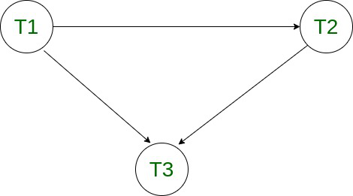
Lecture
SLIDE 9 / 14
View Serializability Concept
1
View serializability is a broader condition than conflict serializability.
2
Two schedules are view equivalent if they produce the same final database state.
3
They must preserve the initial read of data items by transactions.
4
They must preserve the final write of data items by transactions.
5
Some schedules are view serializable but not conflict serializable.
Source: media.geeksforgeeks.org
Chandigarh University
9 / 14
Notes:
View serializability is a more relaxed condition than conflict serializability. It focuses on the final state of the database rather than just the order of operations. A schedule might not be conflict serializable but still produce the correct final result. This allows for more concurrency in certain scenarios.

Slide 10
Lecture
SLIDE 10 / 14
Recoverable Schedules
1
A schedule is recoverable if no transaction commits before the transactions it reads.
2
If T1 reads data written by T2, T1 must wait for T2 to commit.
3
If T2 aborts after T1 reads its data, T1 must also abort.
4
Non-recoverable schedules can lead to cascading rollbacks and data loss.
5
Recoverability ensures the database remains consistent after a failure.
Chandigarh University
10 / 14
Notes:
Recoverability is crucial for handling failures. If T1 reads data from T2, T1 cannot commit until T2 commits. If T2 fails, T1 must also roll back to avoid reading uncommitted data. This prevents cascading rollbacks where multiple transactions have to undo their work.

Slide 11
Lecture
SLIDE 11 / 14
Cascading Rollbacks Explained
1
A cascading rollback occurs when one transaction abort forces others to abort.
2
This happens in non-recoverable schedules where uncommitted data is read.
3
If T2 aborts, all transactions that read T2's data must also abort.
4
This leads to significant performance degradation and wasted processing time.
5
Recoverable schedules prevent cascading rollbacks by enforcing commit dependencies.
Chandigarh University
11 / 14
Notes:
Imagine a chain reaction where one failure causes a domino effect. If T2 aborts, and T1 read T2's data, T1 must also abort. This is a cascading rollback. It wastes resources because T1 has to redo its work. Recoverable schedules prevent this by ensuring T1 waits for T2 to commit.

Slide 12
Lecture
SLIDE 12 / 14
Common Pitfalls in Scheduling
1
Assuming all concurrent schedules are serializable without checking.
2
Ignoring the order of read-write operations when analyzing conflicts.
3
Overlooking the need for recovery in non-recoverable schedules.
4
Confusing view serializability with conflict serializability criteria.
5
Failing to detect cycles in precedence graphs correctly.
Chandigarh University
12 / 14
Notes:
Students often assume any concurrent schedule is safe, which is a dangerous misconception. You must always check for cycles in the precedence graph. Another common error is confusing view serializability with conflict serializability. Always verify the specific criteria for each type before concluding correctness.

Slide 13
Lecture
SLIDE 13 / 14
Key Takeaways
1
Schedules define the interleaving of operations from concurrent transactions.
2
Conflict serializability ensures correctness by preserving conflict operation orders.
3
View serializability is a broader condition based on final database states.
4
Recoverable schedules prevent cascading rollbacks and ensure data consistency.
5
Precedence graphs are the primary tool for testing serializability.
Chandigarh University
13 / 14
Notes:
To summarize, schedules are the backbone of concurrent execution in databases. We use conflict serializability and view serializability to ensure correctness. Recoverability is essential for handling failures without data loss. Always use precedence graphs to test for cycles and ensure your schedules are valid.

Slide 14
Lecture
SLIDE 14 / 14
References
1
Fundamentals of Database Systems — Ramez Elmasri & Shamkant B. Navathe
2
Database System Concepts — Silberschatz, Korth & Sudarshan
3
Database Management Systems — Raghu Ramakrishnan & Johannes Gehrke
4
Oracle/MySQL Documentation — Oracle
Chandigarh University
14 / 14
Notes:
These four references provide comprehensive coverage of transaction management and scheduling. Elmasri and Navathe offer a strong theoretical foundation for serializability. Silberschatz provides excellent practical examples of scheduling algorithms. Ramakrishnan and Oracle documentation are essential for implementation details.

